Slide 1

Swift 5.7 - Control Flow
Jiaming Liu
Ji Dang Lab.
2023.02.09

Slide 2
Control Flow contents
For-In Loops
While Loops
Conditional Statements
If
Switch
No Implicit Fallthrough
Interval Matching
Tuples
Value Bindings
Where
Compound Cases
Control Transfer Statements
Continue
Break
Fallthrough
Labeled Statements
Early Exit
Checking API Availability

Slide 3
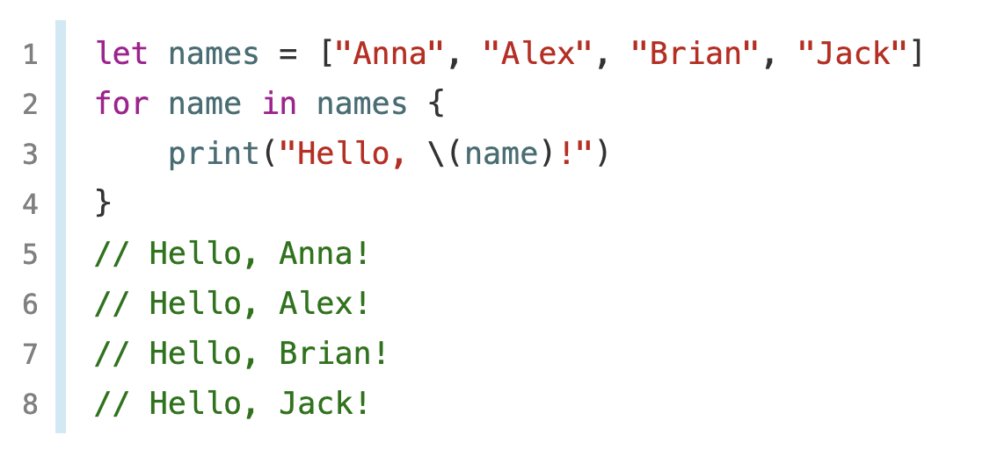
For-In Loops
You use the for-in loop to iterate over a sequence, such as items in an array, ranges of numbers, or characters in a string. (tuples are not a sequence)
This example uses a for-in loop to iterate over the items in an array.

Slide 4
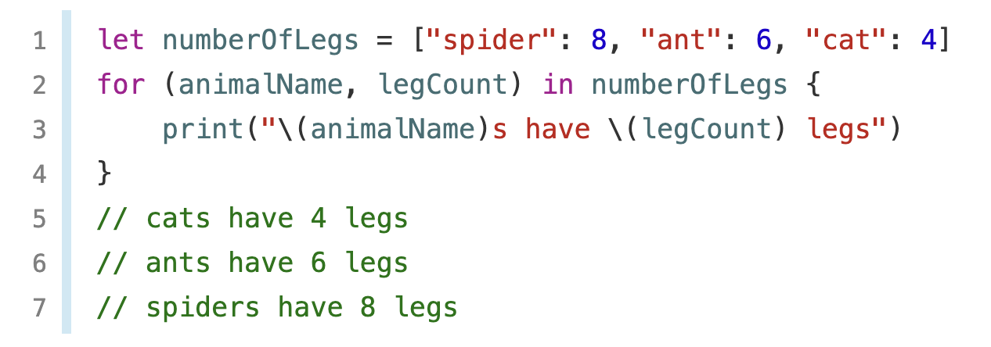
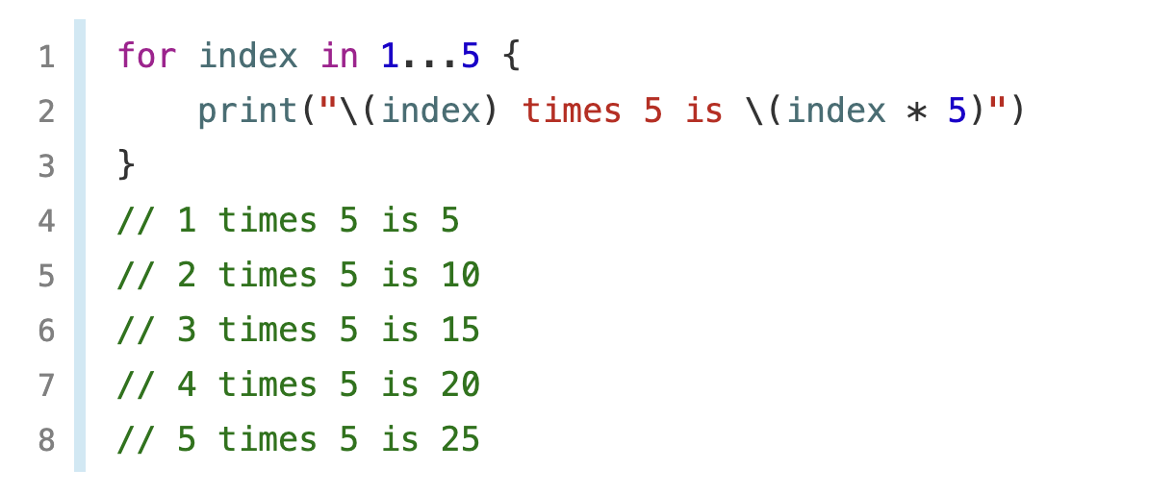
This example uses a for-in loop to iterate over the items in a dictionary.
This example uses a for-in loop to iterate over the items with a numeric range.

Slide 5
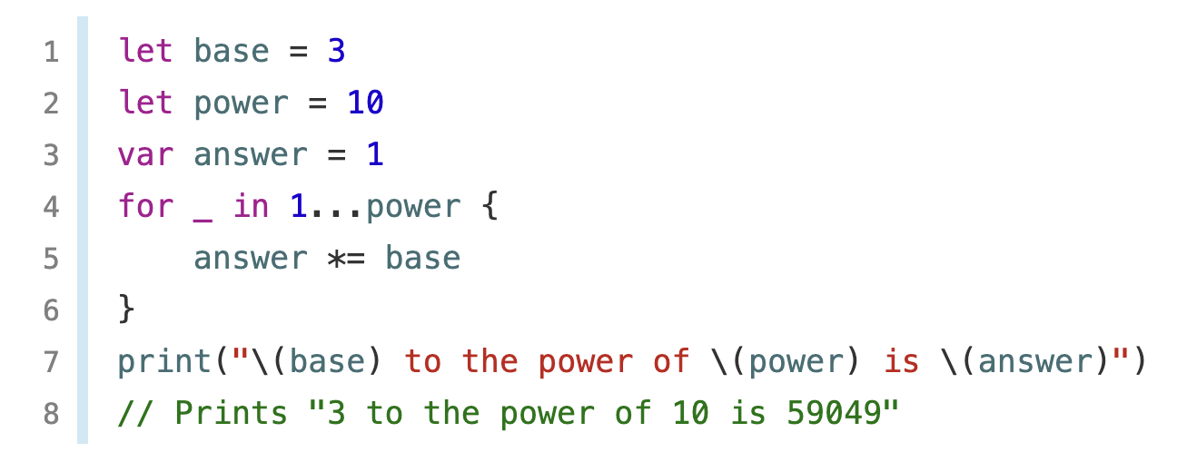
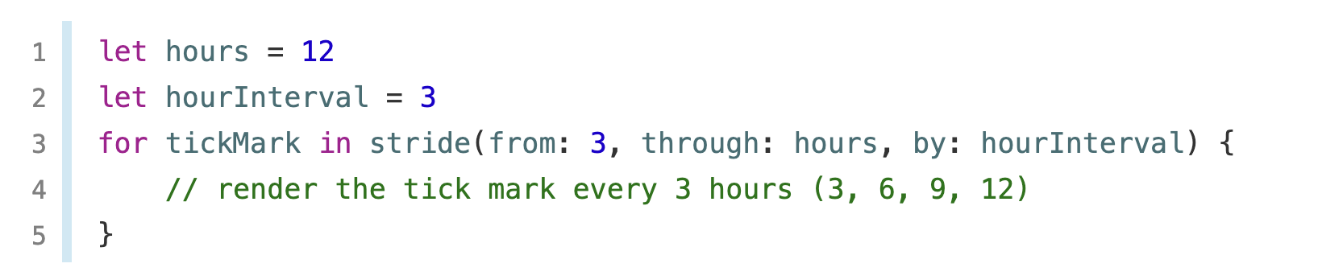
you can ignore the values by using an underscore in place of a variable name.
Using stride function be a sequence (In Python it should be range function)

Slide 6
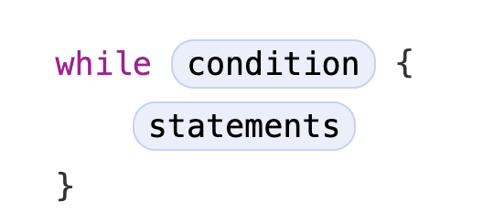
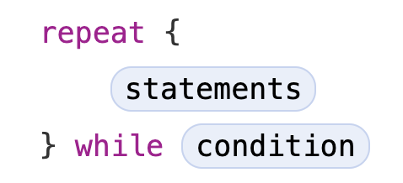
While Loops
A while loop performs a set of statements until a condition becomes false.
Repeat-while loops
//While Loops
var a = 0
while a <= 5 {
a += 1
print(a)
}
//Repeat-while Loops
var b = 0
repeat {
b += 1
print(b)
} while b <= 5

Slide 7
Conditional Statements
Swift provides two ways to add conditional branches.
If (for a boolean or a number )
Switch (for specific value )

Slide 8
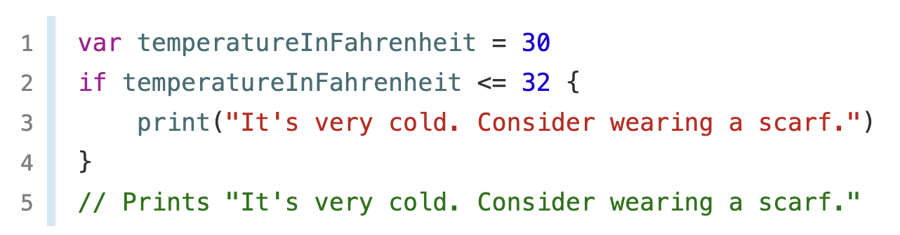
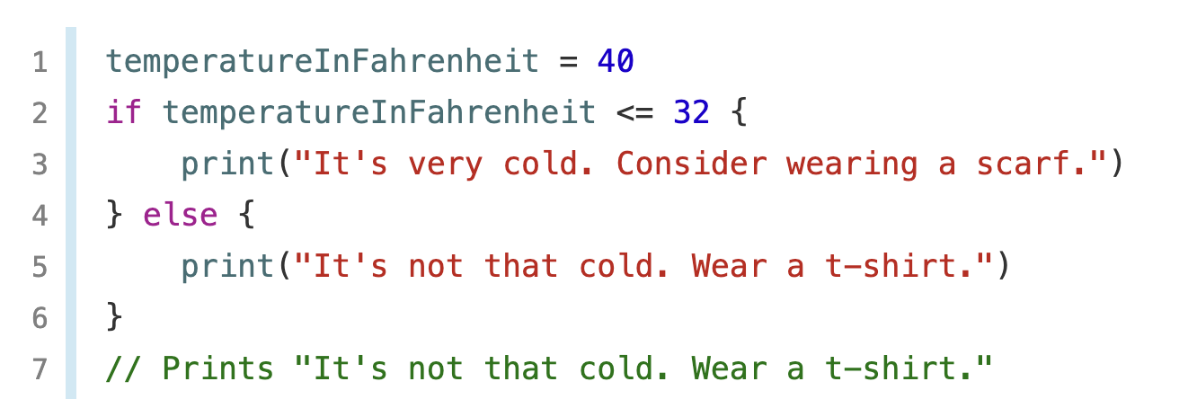
If
30
32
if
if, else
32
40

Slide 9
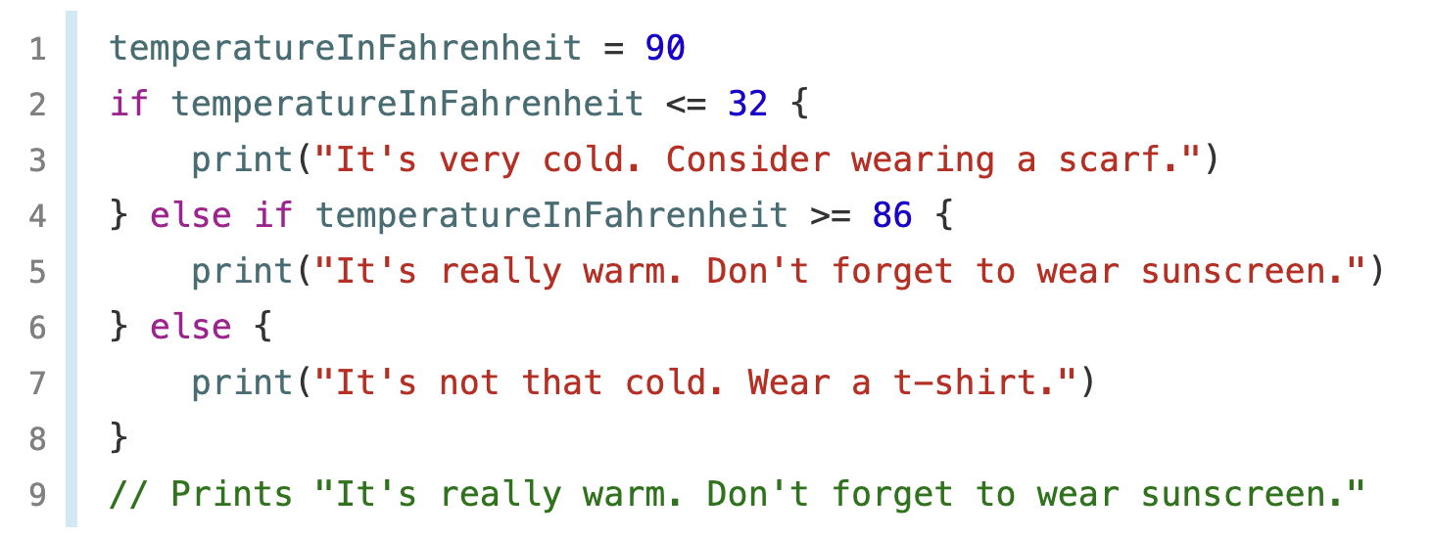
If
multiple if statements
32
86
90

Slide 10
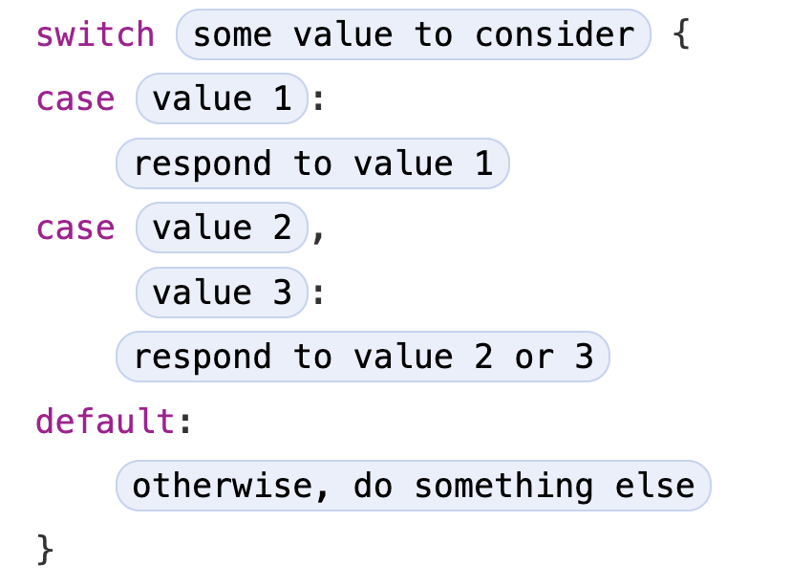
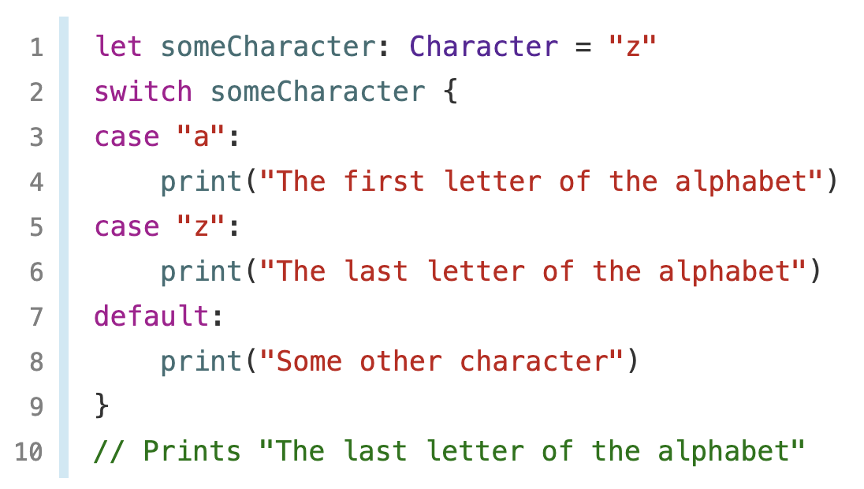
Switch
In addition to comparing against specific values.

Slide 11
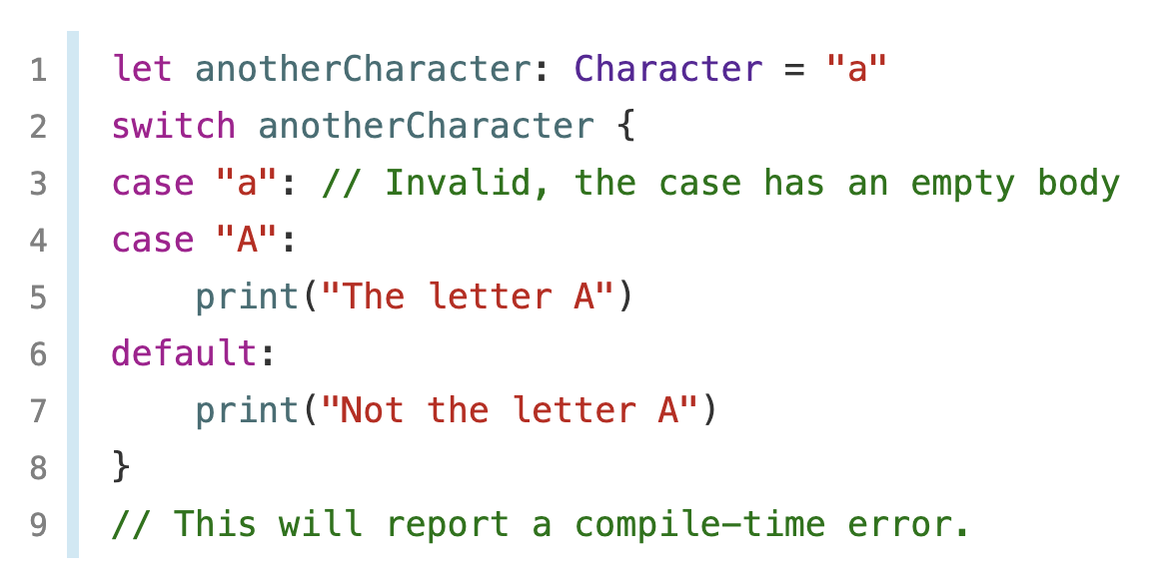
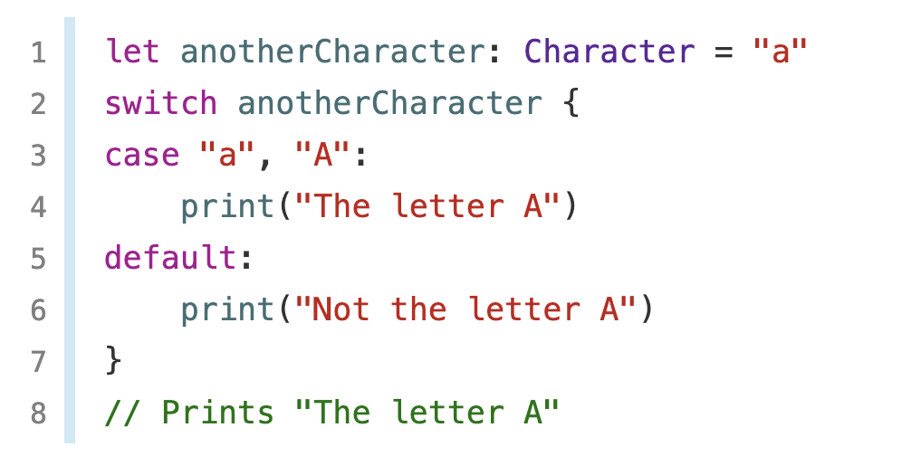
Switch
The body of each case must contain at least one executable statement.
We can combine the two values into a compound case.

Slide 12
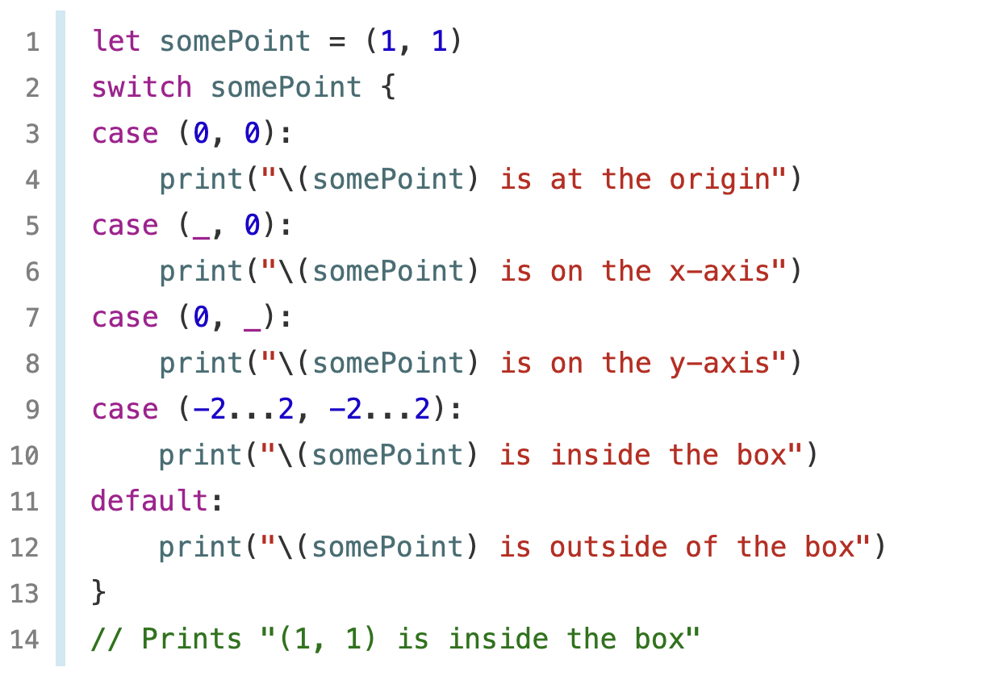
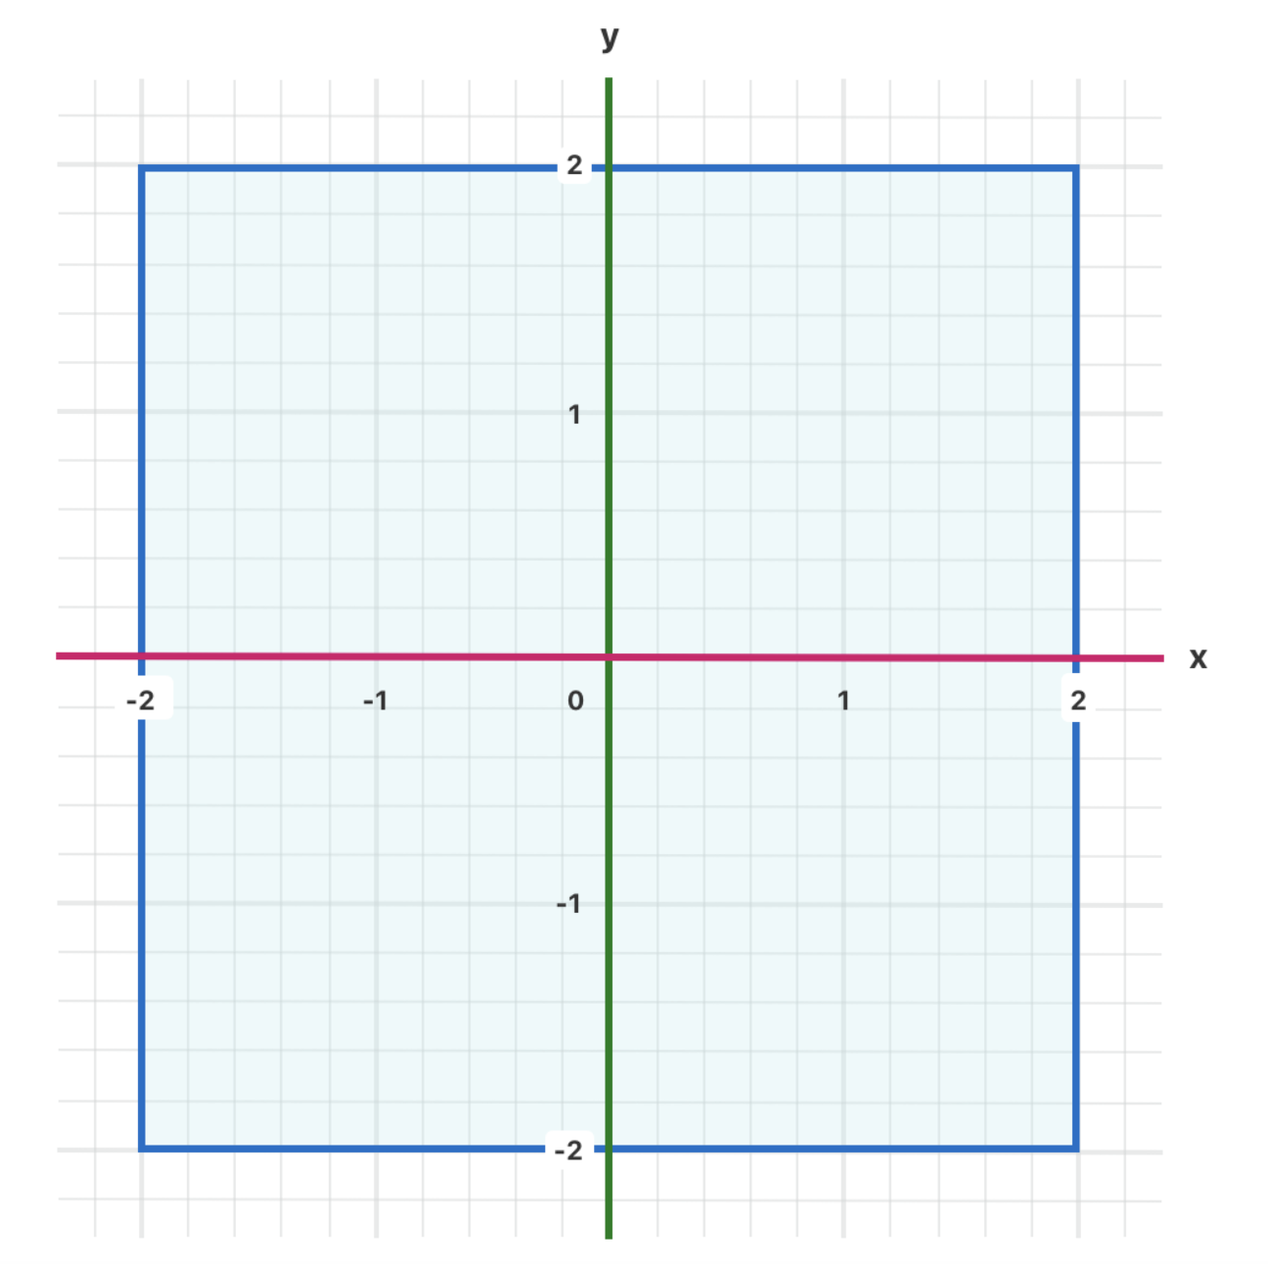
Switch by tuples

Slide 13
Control Transfer Statements
Control transfer statements change the order in which your code is executed.
Swift has five control transfer statements:
continue
break
fallthrough
return
throw

Slide 14
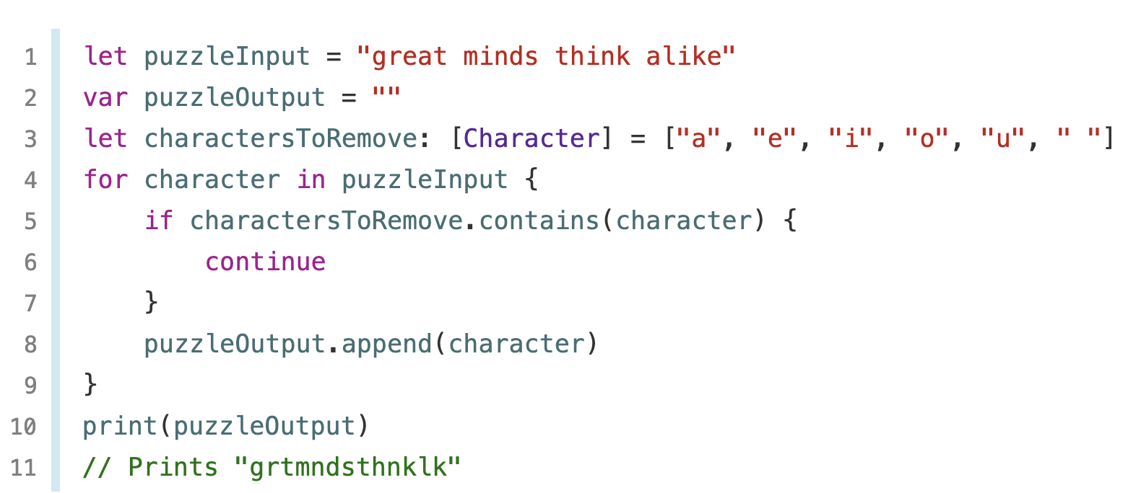
Continue
The continue statement tells a loop to stop what it’s doing and start again at the beginning of the next iteration through the loop.

Slide 15
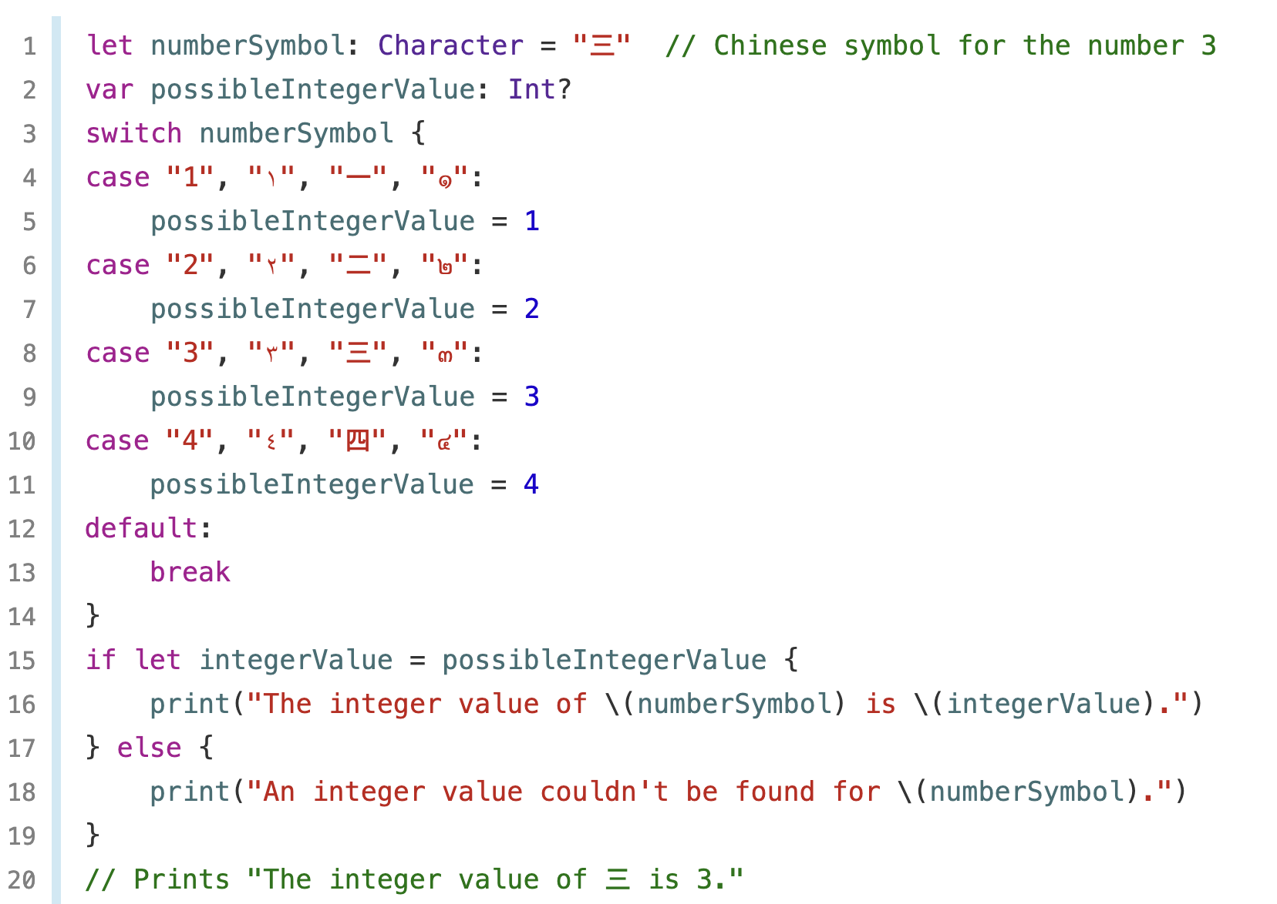
Break
The break statement ends the execution of an entire control flow statement immediately.

Slide 16
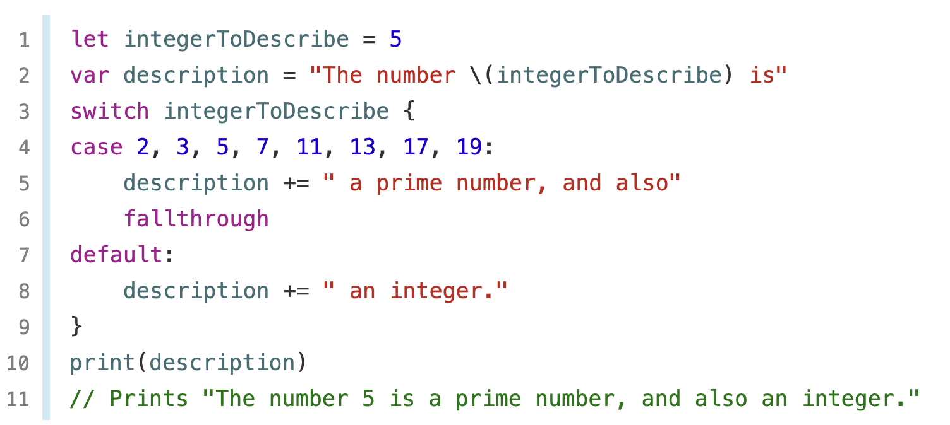
Fallthrough
Match multiple cases

Slide 17
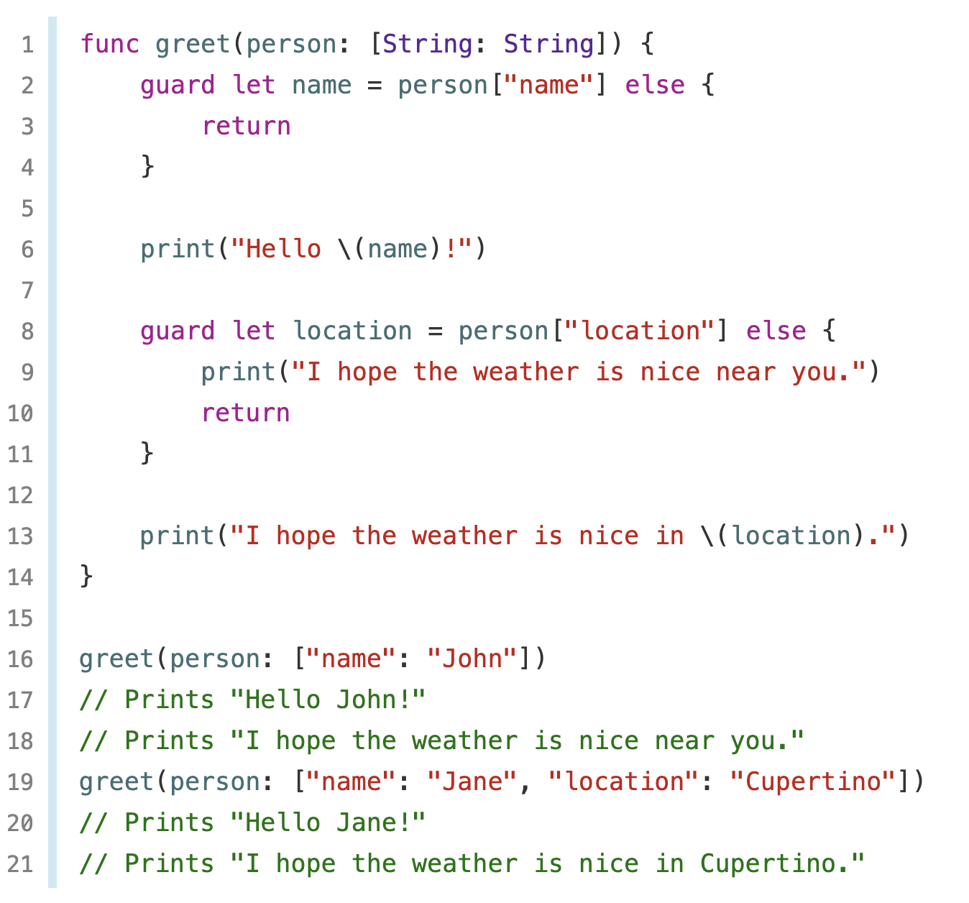
Early Exit - guard
A guard statement always has an else.
Using a guard statement for requirements improves the readability of your code.

